Slide 1
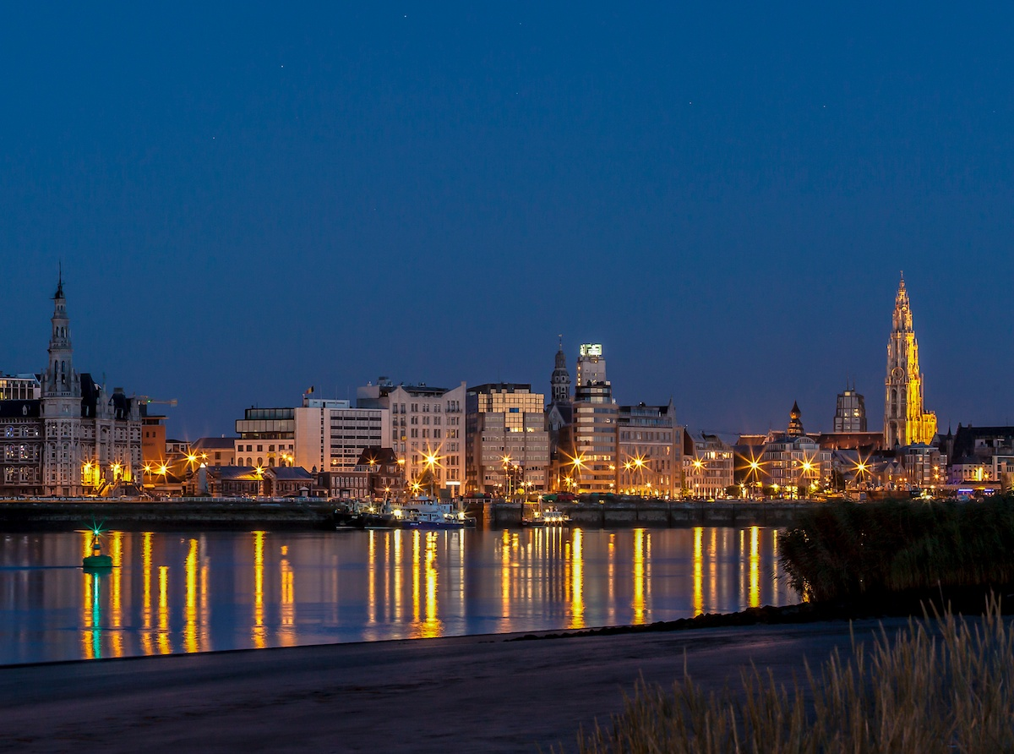

November 2013

Slide 2
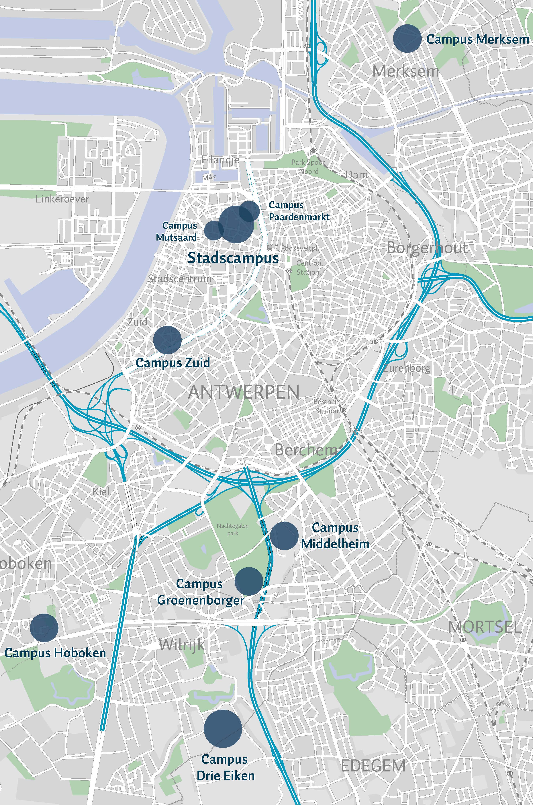
Antwerp Student City
44.000 students in higher education (University, University Colleges and Academy)
2nd largest student city of Flanders
University of Antwerp
  Currently nine campuses
  Near future: some major relocations
  From nine to six campuses
Notes:
Van 9 naar 6 campussen
Industrieel ingenieurs van Campus Hoboken en Campus Paardenmarkt verhuizen in 2016 naar Campus Groenenborger
Revalidatiewetenschappen en kinesitherapie verhuizen van Campus Merksem naar Campus Drie Eiken
Toegepaste Taalkunde (Vertalers Tolken) verhuizen naar Stadscampus

Slide 3
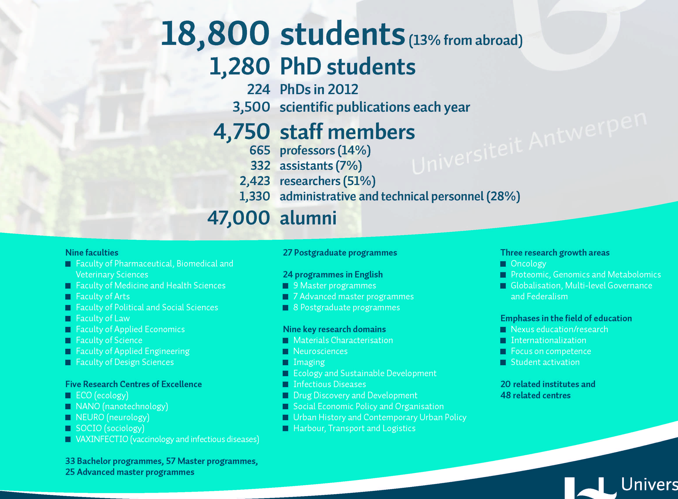

Slide 4

Top 50 Universities under 50, 2014:
10th place worldwide

Slide 5
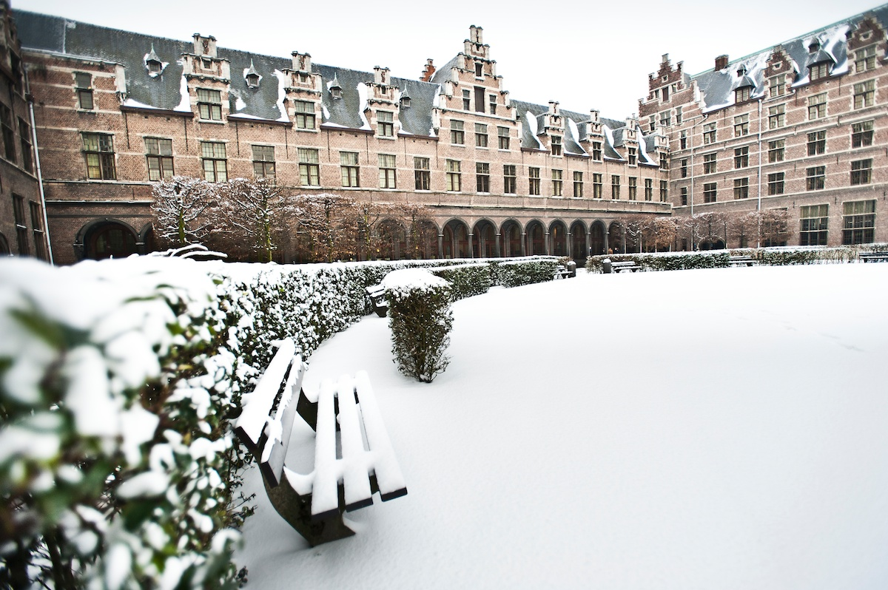
Faculty of Law City Campus

Slide 6
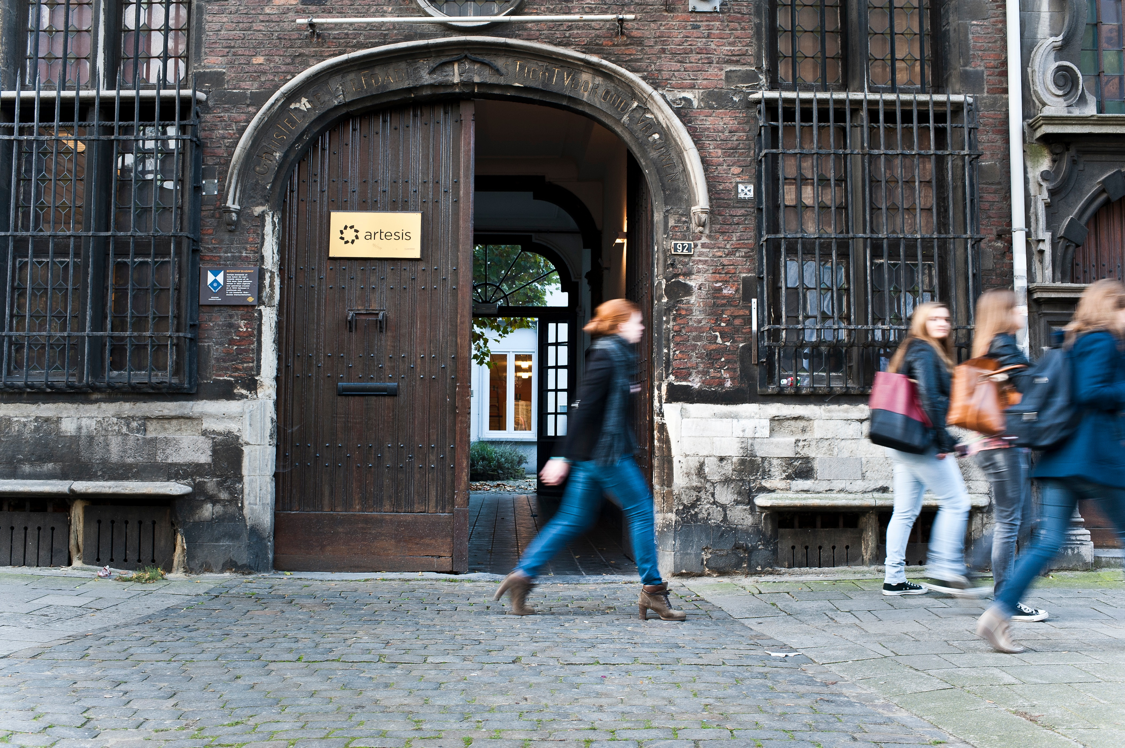
Campus Paardenmarkt

Slide 7
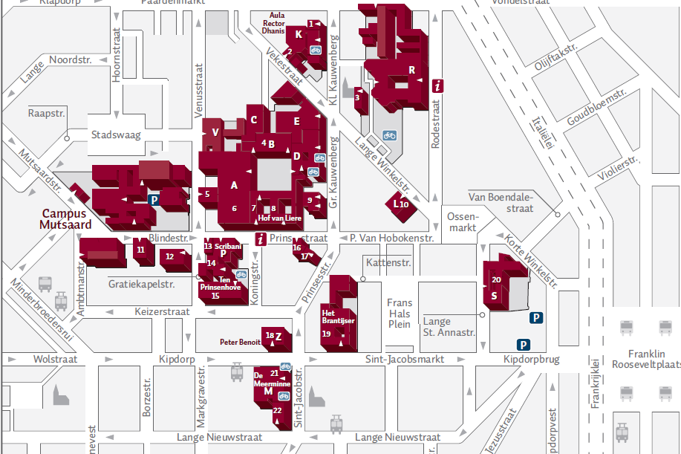

Slide 8
Faculty of Law
1600 students enrolled in one of the following programmes
  bachelor of laws (3 yrs)
    +/- 375 first year students
  master of laws (2 yrs)
    +/- 140 graduates per year
  master in safety sciences (2 yrs)
  advanced master in tax law (1 yr)
  advanced master in corporate law (1 yr)
  doctoral programme in law
    general programme
    specific programmes in ‘Globalisation and Legal Theory’ and ‘Globalization and Economic Law’
  www.uantwerpen.be/rechten

Slide 9
Faculty of Law
approximately 80 incoming exchange students per year
  mostly EU (Erasmus Socrates exchange)
  also bilateral exchanges (Australia, Brazil, China, India, Puerto Rico, South Africa, United States)
English programme for incoming exchange students: IELSP
  International and European Legal Studies Programme (1 yr)
  leading to a certificate
  6 courses per term

Slide 10
International and European Legal Studies Programme (IELSP)
  IELSP
  per semester 4 mandatory courses+ 2 optional
  5 credits per course
  certificate
  Incoming students at least 15 credits per semester

Slide 11
1st semester
Mandatory courses
Constitutionalism in a European and International Perspective (D. Vanheule)
Institutional Law of the European Union (H. De Waele)
European Economic Law (N.)
European Competition Law (A.-M. Van den Bossche)
Optional courses (students choose two out of four)
Advanced International Law (K. De Feyter)
European Information and Communications Law (P. Van Eecke)
International and European Labour and Social Security Law (H. Verschueren)
International and European Health Law (S. Lierman)

Slide 12
2nd Semester
Mandatory courses
Law and Globalisation (G. Pavlakos)
International and European Protection of Human Rights (W. Vandenhole)
External Relations of the European Union (H. De Waele)
Law of the World Trade Organisation (A. Herwig)
  Optional courses (students choose two out of three)
  Law of global transactions and litigation (M. Pertégas)
  European and Comparative Discrimination Law (D. Cuypers) European Private Law (E. van Zimmeren)
  www.uantwerpen.be/IELSP

Slide 13
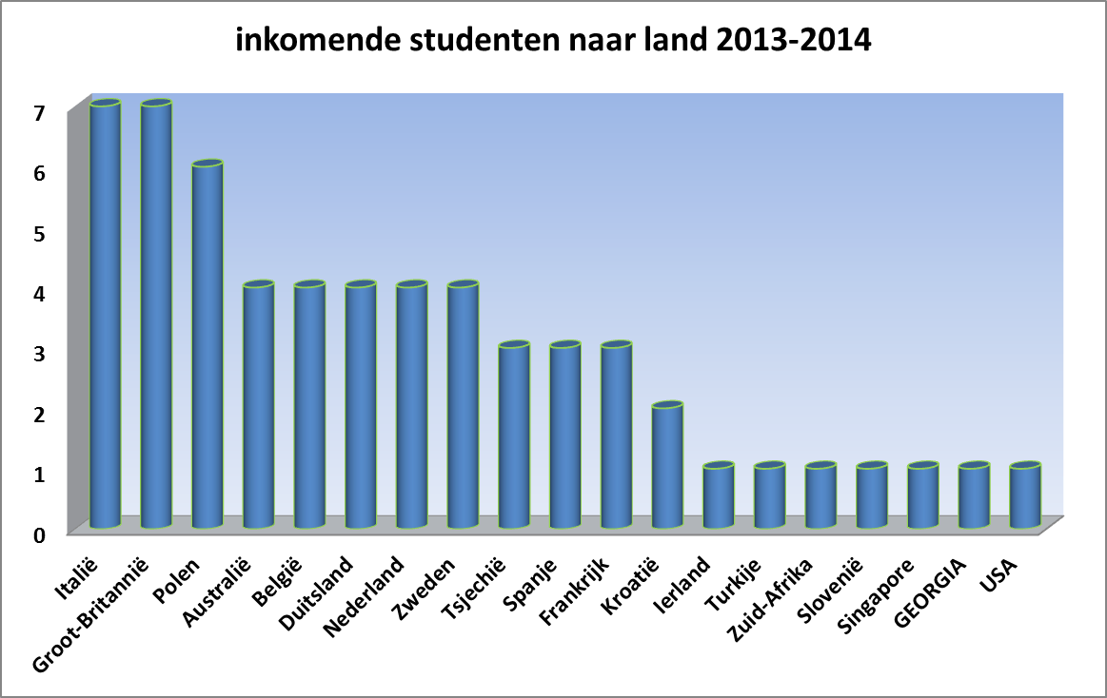

Slide 14
Faculty of Law
research
  academic staff
    29 full time professors, 45 parttime professors, 50 research and teaching assistants
  working in six research groups
    Business & Law,
    Government & Law,
    Law and Development,
    Law Enforcement, and
    Personal Rights & Property Rights,
    Social Competition and Law.
  www.uantwerp.be/en/faculties/faculty-of-law/research/groups/

